Slide 1
Snow leopard
By: Loreley, Diana, and Sarah

Slide 2
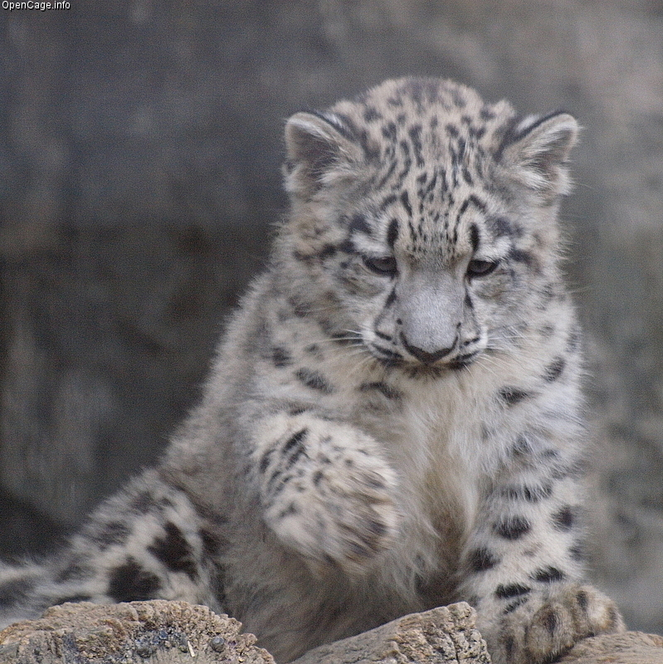
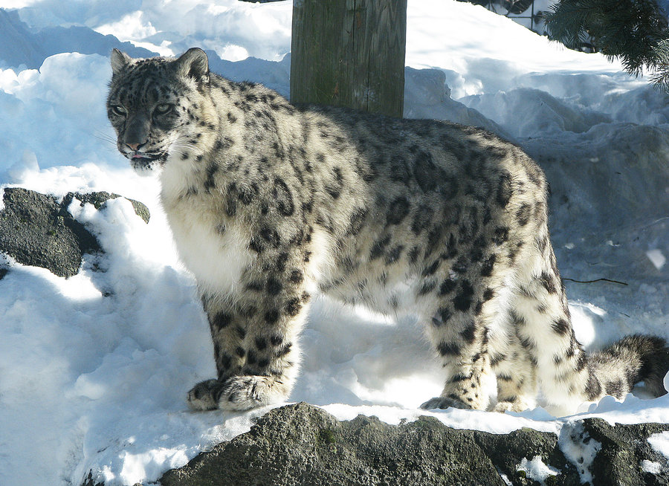
Size
A SNOW LEOPARD IS 4 TO 5 FT TALL

Slide 3
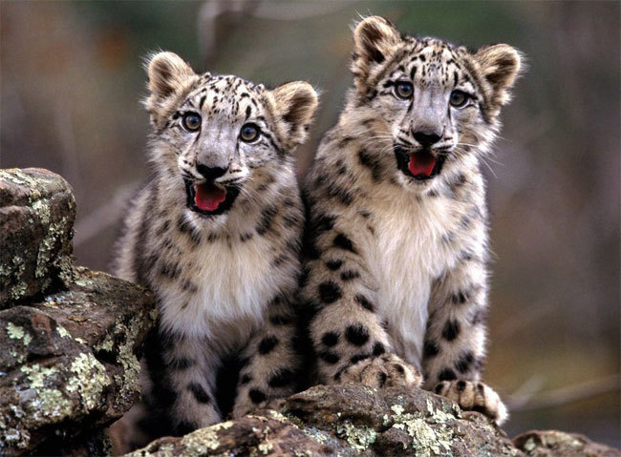
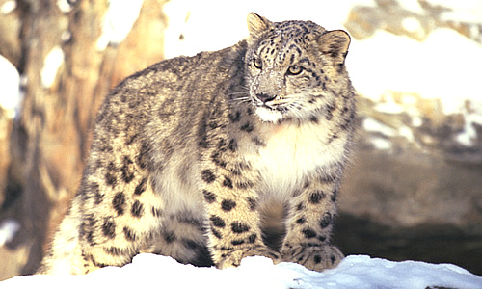
WHAT IT LOOKS LIKE
HAS WHITE , YELLOWISH OR SOFT GRAY COAT WITH RINGED SPOTS BLACK AND BROWN IT HAS FUR

Slide 4
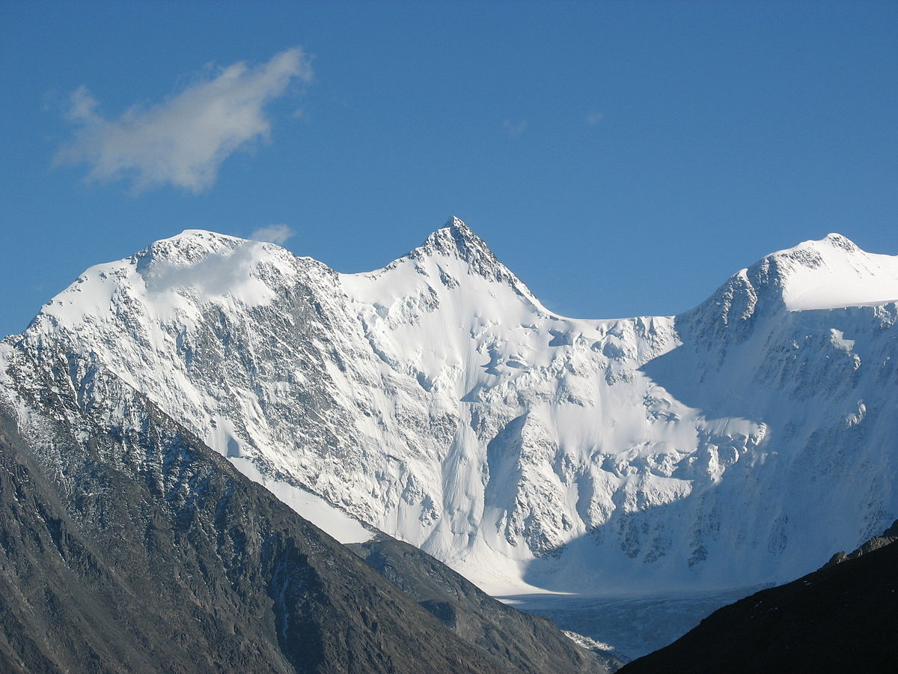
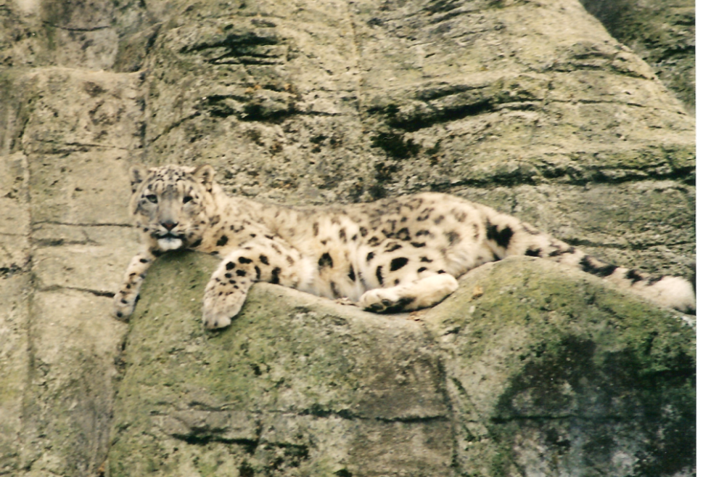
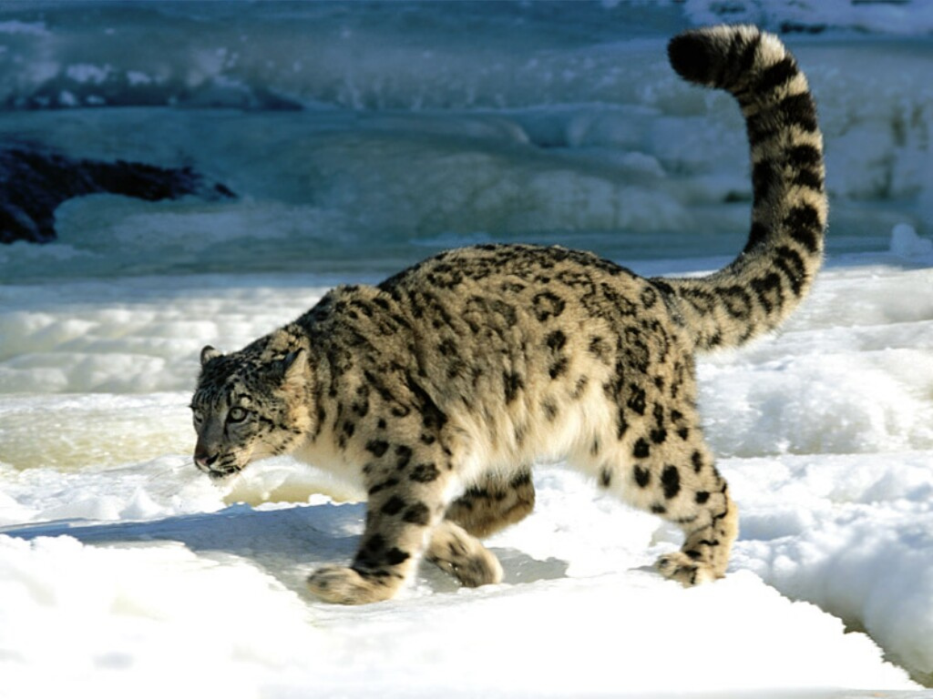
HABITAT
THEY CAN BE FOUND AT .… CENTRAL ASIA , RUSIA , AND CHINA

